Slide 1
Maze Solving with a* algorithm

Slide 2
The Team team 2
Khandakar Mahedi Hasan
21101031
Md. Bijoy
21101033
Naimur Rashid Niloy
21101013

Slide 3
AGENDA
Maze
A* algorithm
Path cost
Heuristic
Summary
Links & references

Slide 4
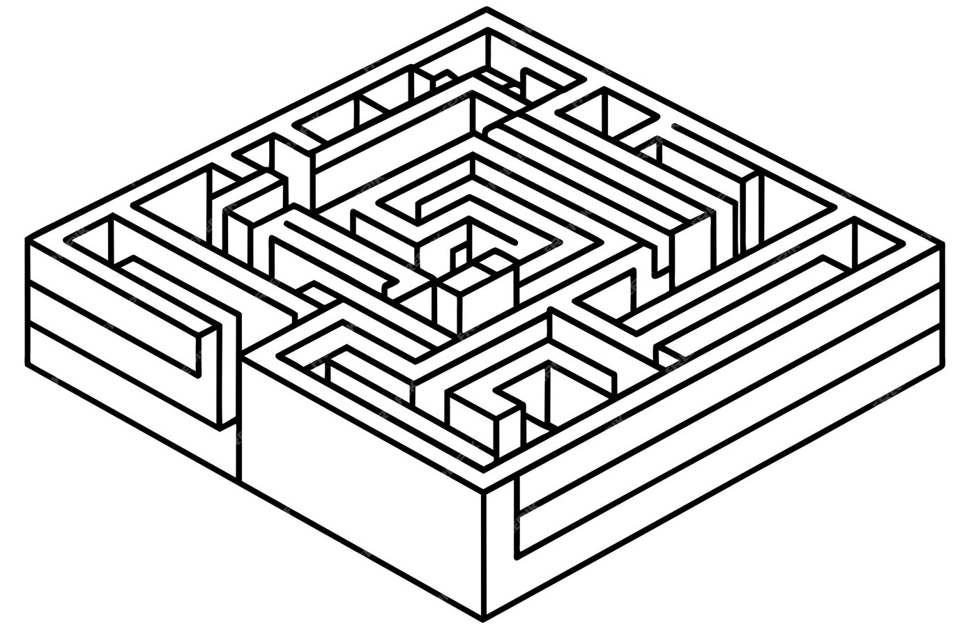
Maze

Slide 5
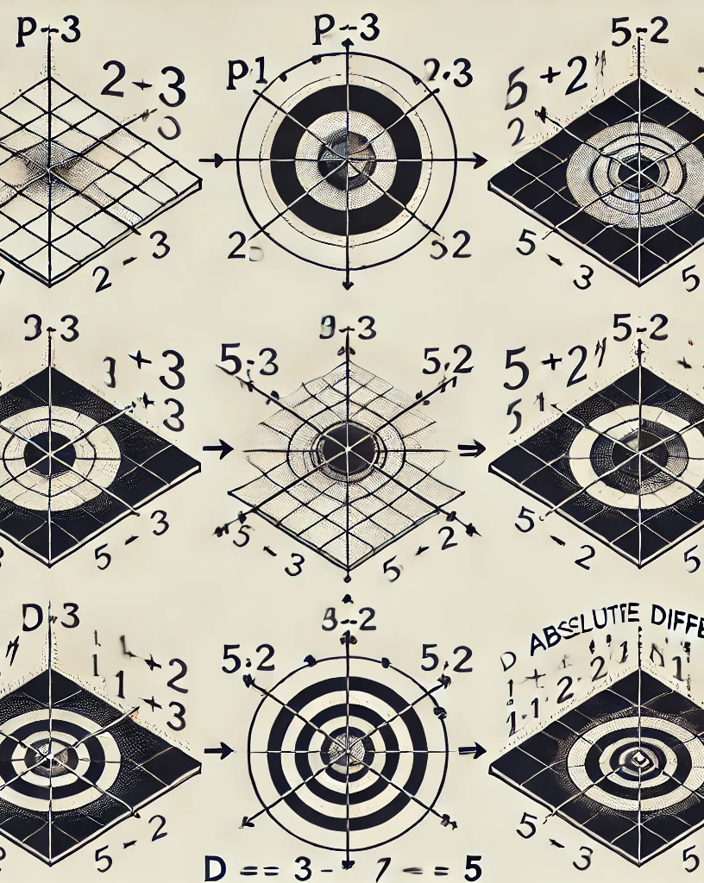
A* algorithm

Slide 6
Path cost

Slide 7
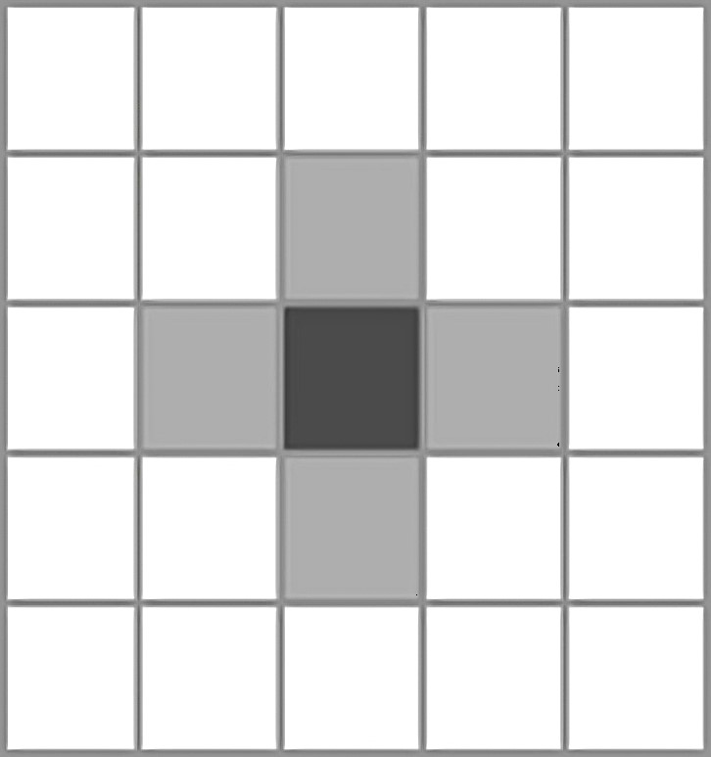
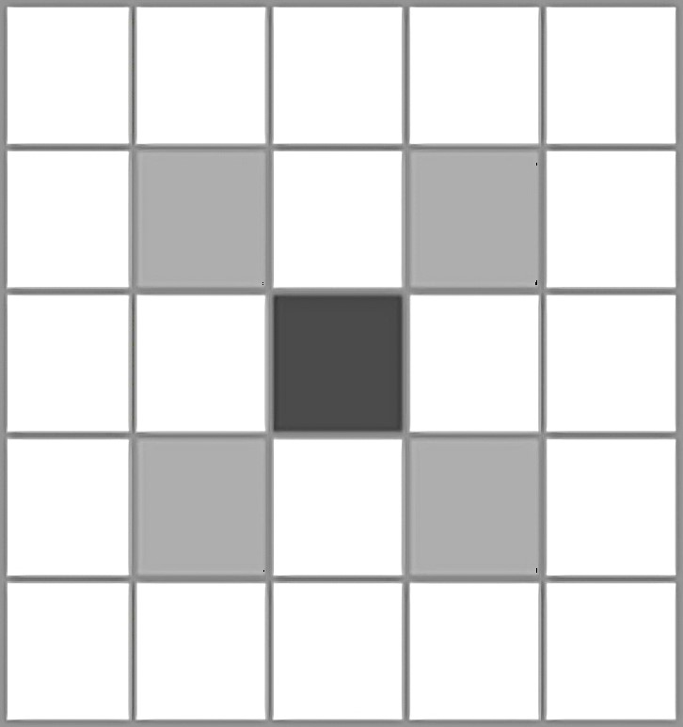
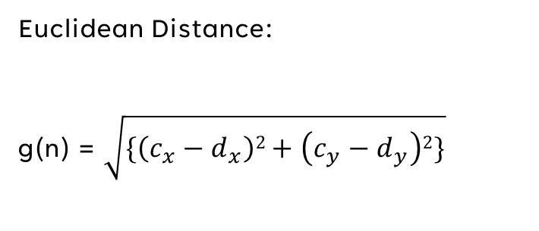
Path cost calculation
Cardinal
Euclidean Distance:
g(n) = $\sqrt{\{\left(c_{x}−d_{x}\right)2+\left(c_{y}−d_{y}\right)2\}}$
Diagonal

Slide 8
Heuristic

Slide 9
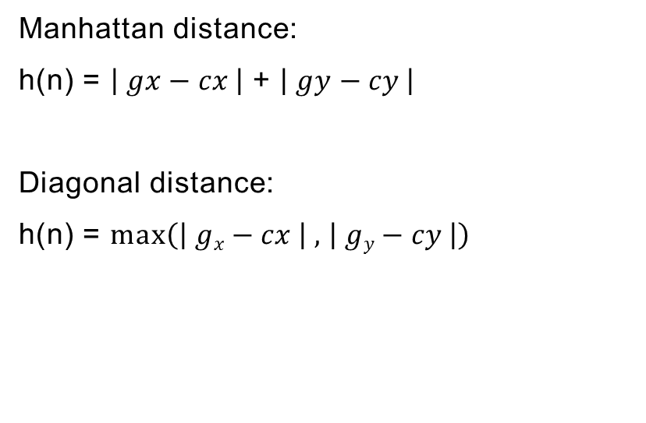
Heuristic Calculation
Manhattan distance:
h(n) = $\left| gx−cx \right|$ + $\left| gy−cy \right|$
Diagonal distance:
h(n) = max$\left(\left| gx−cx \right|\text{ , }\left| gy−cy \right|\right)$

Slide 10
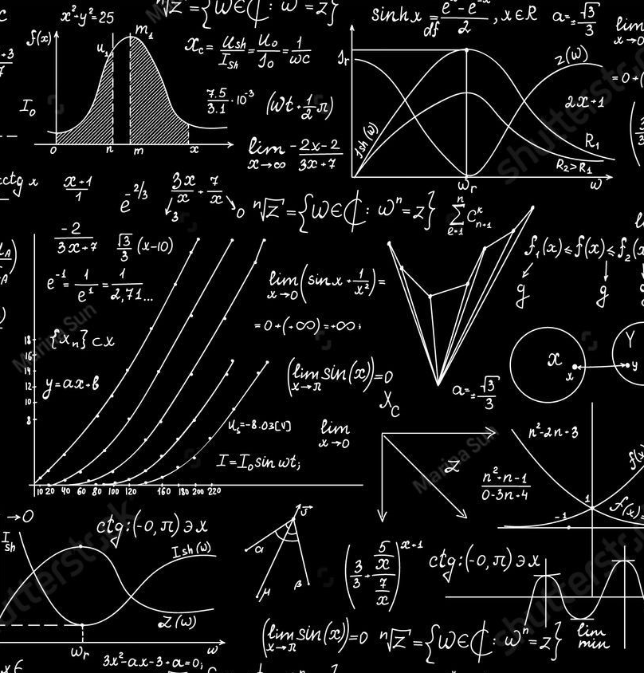
Summary

Slide 11
Links and reference
Code links:
Colab: https://colab.research.google.com/drive/1AM0c4wj1_VL9-pX9MbIv2Fr2YJStTsaG?usp=sharing
Github: BlackSparrow99/Maze_Solver (github.com)
Google drive:
https://drive.google.com/drive/folders/1eHVwsSK3V9buvDY1qwWxOEq5yNldW8jR?usp=sharing
References and source links:
www.geeksforgeeks.org
www.youtube.com
CSE 403 theory
www.tutorialspoint.com

Slide 12
THANK YOU
Mahadi
21101031@uap-bd.edu
Bijoy
21101033@uap-bd.edu
Niloy
21101013@uap-bd.edu

